Slide 1
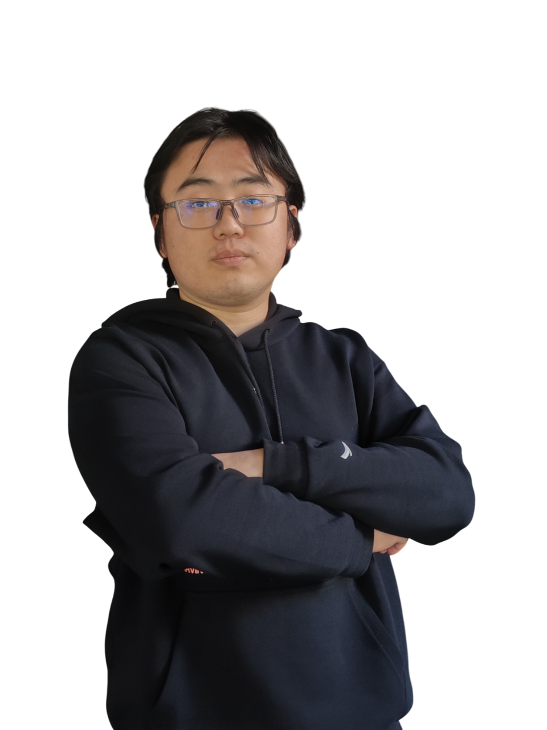
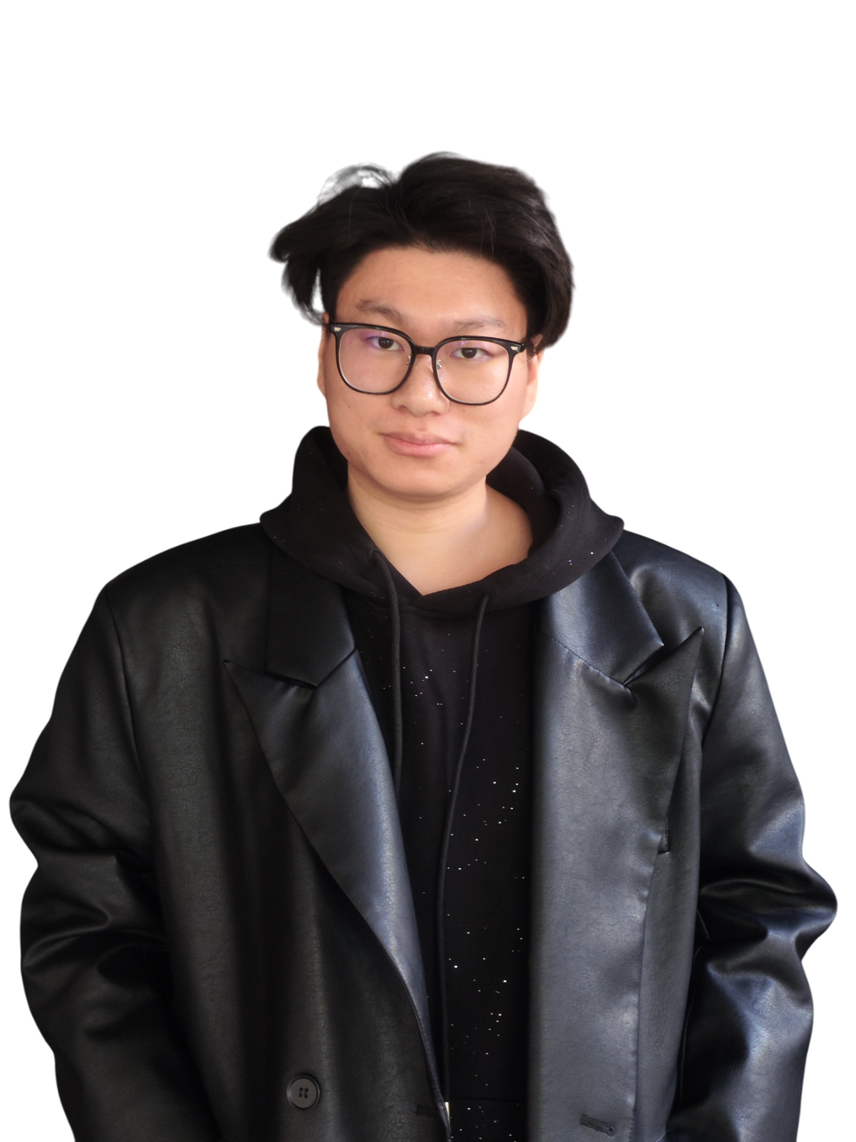
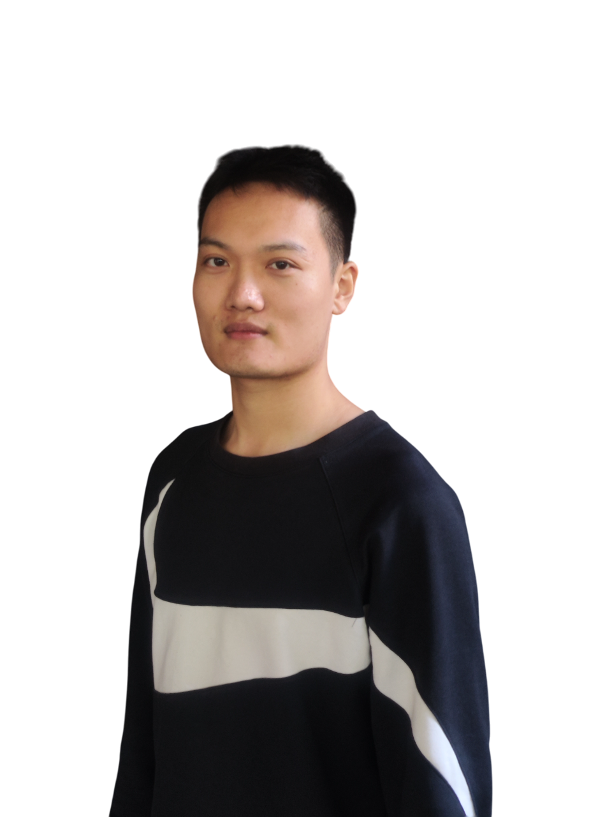
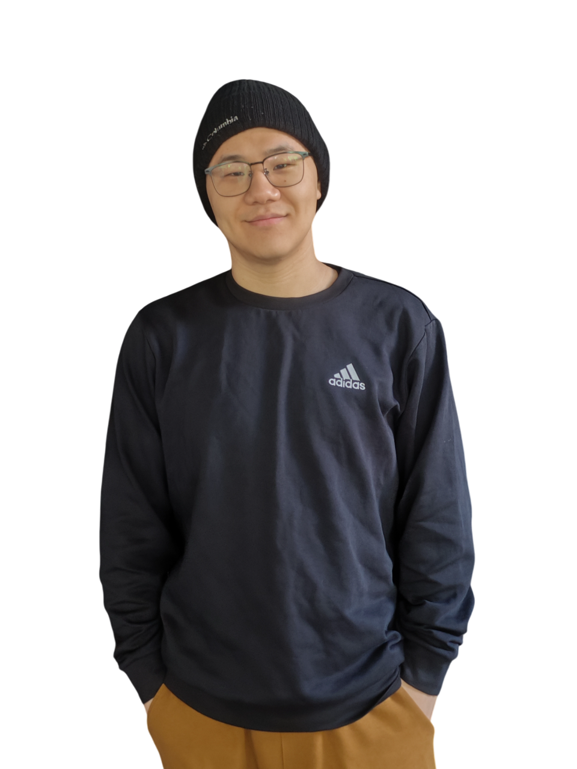
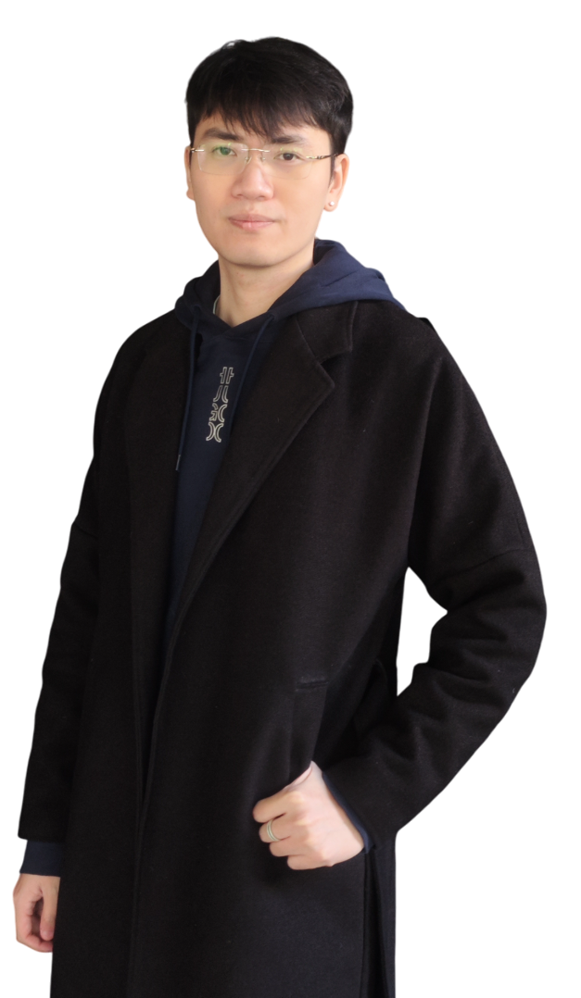
Zhi Zhao
Developer
Yunhao Zhou
Visual Designer
Zewen Liang
Developer
Yuying Zhang
Copywriter
Kaijie Xu
Project Manager
GROUP 8

